Slide 1
RENTAL SYSTEMS FOR FARMERS
PIP104 PROFESSIONAL PRACTICE-II
VIVA-VOCE
Batch Number:56
Roll Number | Student Name
20201CCS0041 | THORUGU DILEEP KUMAR
20201CCS0012 | NIMMALA PAVAN KUMAR
20201CCS0019 | GAJULA KISHORE KUMAR
20201CCS0055 | NUTHANAPATI RANJITH KUMAR
Under the Supervision of,
Ms.SOUMYA
Assistant Professor
School of Computer Science Engineering & Information Science
Presidency University

Slide 2
Introduction
SmartFarm Rules: Optimizing Agricultural Rentals
SmartFarm Rules, akin to Yara rules in cybersecurity, are a powerful tool for customizing and classifying equipment rentals in agriculture. Written in a specific syntax, they empower stakeholders to create tailored rules for efficient and sustainable equipment usage.
Purpose: SmartFarm Rules enable professionals to create custom rules for identifying specific patterns in agricultural equipment rentals, promoting efficiency and resource optimization.
Application Areas: Widely applied in agricultural technology, SmartFarm Rules optimize equipment rentals by tailoring agreements, schedules, and machinery choices. They enhance resource allocation, adapt to seasonal variations, and provide cost-effective solutions for farmers.

Slide 3
Literature Review
Title of the project : Agriculture Equipment’s Rental System
Summary :
The Agriculture Equipment’s Rental System operates as a centralized, web-based platform.
Designed for businesses and individuals, the platform facilitates efficient hiring and renting of farming equipment..
Users benefit from easy access to a variety of agricultural machinery, ultimately enhancing farming operations.
Drawback :
Farmers may resist the adoption of the technology-driven rental system due to challenges in digital literacy and limited access to technology, hindering widespread acceptance.

Slide 4
Literature Review
Title of the project :
Optimization of Machinery Use on Farms with Emphasis on Timeliness Costs
Summary:
The project centers on analyzing the timeliness costs linked to machinery use on farms, aiming to quantify and understand their impact on overall farm expenses..
A key focus is to examine how timeliness costs directly affect farmers' revenues, providing insights into the financial implications of machinery-related timing issues..
Drawback :
Resistance and challenges among farmers, including digital literacy issues, limited technology access, and reluctance to change, may hinder the broad adoption of optimized machinery use. This limits the overall impact on farm operations.

Slide 5
Research Gaps Identified Agriculture Equipment’s Rental System
Limited Understanding of Technology Adoption Barriers:
There is a research gap in understanding the specific barriers and challenges farmers face in adopting Agriculture Equipment’s Rental System, including factors such as digital literacy, technology access, and attitudes towards technology integration in farming practices.
Economic Impact and Viability Studies:
Research often lacks comprehensive studies on the economic impact and long-term viability of the Agriculture Equipment’s Rental System. Understanding the financial sustainability, cost-effectiveness, and overall economic benefits for farmers is an identified research gap.

Slide 6
Research Gaps Identified Optimization of Machinery Use on Farms with Emphasis on Timeliness Costs
Limited Understanding of Farmer Adoption Factors
There is a research gap in understanding the factors influencing farmers' adoption of optimized machinery use, particularly with an emphasis on timeliness costs. Factors such as digital literacy, technology acceptance, and the willingness to change are essential areas for further investigation.
Economic Implications and Farmer Revenues:
Existing research may lack in-depth studies on the economic implications of optimized machinery use on farmer revenues. Research gaps exist in understanding how timeliness costs directly impact the financial outcomes for farmers.

Slide 7
Proposed Methodology
User-Friendly Interface Design:
Prioritize the development of a user-friendly interface for the rental system, ensuring ease of navigation and accessibility for farmers with varying levels of digital literacy.
Comprehensive Needs Assessment:
Conduct a thorough needs assessment to understand the specific requirements and challenges faced by farmers in accessing and utilizing agricultural equipment. This includes surveys and focus group discussions to gather insights into user preferences, constraints, and technological capabilities.

Slide 8
Proposed Methodology
System Design with User-Centric Principles:
Based on the findings from the needs assessment and feasibility study, initiate the system design phase with a focus on user-centric principles. Ensure an intuitive and seamless experience for both farmers and equipment providers. This involves interface design, workflow mapping, and defining user roles.
Technology Stack Selection:
Select an appropriate technology stack aligning with the project's objectives. Consider programming languages, frameworks, and databases that prioritize scalability, security, and compatibility with existing agricultural systems.
Development and Testing:
Implement agile development methodologies for building the Farmer Equipment Rental System based on the approved design and technology stack. Conduct continuous testing to ensure the reliability, functionality, and security of the system.

Slide 9
Objectives
Enhanced Accessibility:
Develop a user-friendly platform that enhances accessibility for farmers, facilitating easy navigation and interaction with the rental system.
Optimized Equipment Utilization:
Streamline the rental process to ensure efficient and optimized utilization of agricultural machinery, reducing underutilization and minimizing manual record-keeping errors.
Cost-Effective Solutions for Small Farmers:
Implement smart farming solutions within the rental system to provide cost-effective machinery rental options, particularly benefiting small-scale farmers facing financial constraints.

Slide 10
Objectives
4.Timeliness and Cost Optimization:
Address timeliness costs associated with machinery use on farms, ensuring optimal operational schedules and minimizing expenses to positively impact farmers' revenues.
5.Technological Integration:
Implement a sophisticated rental platform using HTML, CSS, Python, Django Framework, and Database Integration to create a seamless and technologically advanced user experience.
6.User-Centric Design:
Ensure user-friendly modules, including User Management, Machinery Inventory, and Data Analytics, making the system accessible and beneficial for both farmers and machinery providers.

Slide 11
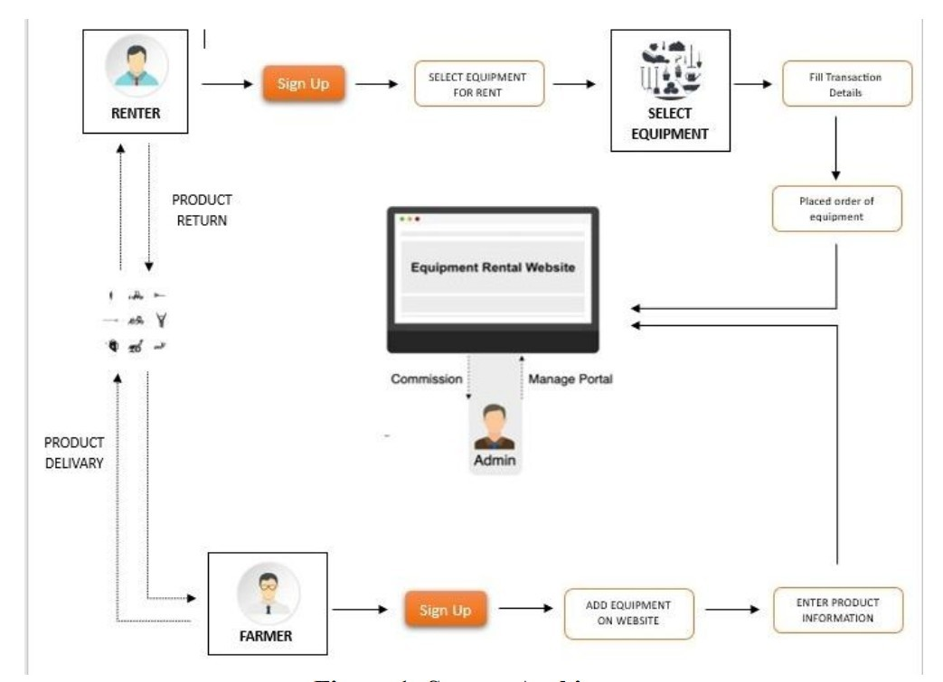
System Design & Implementation

Slide 12
Timeline of Project
Stage of project | 12-10-2023 | 05-12-2023 | 22-12-2023
Confirmation of Project title. (review 0)
Hard copy of project (review 1)
50% Demonstration (review 2)
100% Demonstration (review 3)

Slide 13
Outcomes / Results Obtained
Improved Equipment Accessibility:
Farmers experience enhanced accessibility to a diverse range of agricultural machinery through the rental system, enabling them to choose equipment that aligns with their specific needs.
Optimized Resource Utilization:
The streamlined rental process contributes to optimized resource utilization, reducing instances of underutilization and promoting more efficient farming practices.
Cost-Efficient Solutions for Small Farmers:
Implementation of smart farming solutions results in cost-effective machinery rental options, providing significant financial benefits for small-scale farmers facing budget constraints.

Slide 14
Outcomes / Results Obtained
4.Timeliness and Cost Optimization:
Addressing timeliness costs associated with machinery use positively impacts farmers' revenues by ensuring optimal operational schedules and minimizing unnecessary expenses.
5.Technologically Advanced Platform:
The incorporation of HTML, CSS, Python, Django Framework, and Database Integration results in a technologically advanced rental platform, providing a seamless and efficient user experience for both farmers and machinery providers.
6.User-Centric Design Implementation:
The user-friendly modules, including User Management, Machinery Inventory, and Data Analytics, contribute to a system that is accessible and beneficial for farmers and machinery providers alike.

Slide 15
Conclusion
Efficient Equipment Access:
The Rental System streamlines equipment access, enhancing overall agricultural efficiency through optimized resource utilization.
Financial Inclusivity:
Cost-effective solutions and smart farming options in the system address financial constraints for small-scale farmers, promoting economic sustainability and sector inclusivity.
Technological Modernization:
The integration of cutting-edge technologies and a user-centric design signifies a step towards the modernization of farming, ensuring long-term sustainability and growth.

Slide 16
References
1.Bhaskar G, Lakshmi Murthy, Sharma V P, 2017. Extension Digest: Mobile apps empowering farmers. 2017. 1(2): 3-35
2.Amrit Patel, 2016. Digital India: Reaching to small, Marginal & Women Farmers. International Journal of Scientific Research in Computer Science, Engineering and Information Technology, 1(2):46-53.
3.Cl air e J Gle ndenn ing , Suresh Babu an d Kwadw o Asen so-Okyere.2010.Review of Agricultural Extension in India: Are Farmers’ Information Needs Being Met IFPRI Discussion Paper 01048
4. Anup Kumar Das and Ranjit Borah. 2017. Decision Oriented Information System for Farmers: A Study of Kisan CallCenters (KCC), Kisan Knowledge Management System (KKMs), Farmers Portal and m-Kisan Portal in Assam. Study No. 149. By Centre for Management in Agriculture (CMA), Indian Inst itute of Management, Ahmedabad (IIMA) and Agro-Economic Research Centre for North-East India, Assam Agricultural University, Assam.

Slide 17
References
5.Ministry of Agriculture, Department of Agriculture and Cooperation, State of Indian Agriculture 2015-16.
6.PIB press release, M/o Agriculture, dt.04.08.2015
7.Hou, J. (2022). [Research on Agricultural Machinery Rental Optimization]. This study explores the utilization of big data in agriculture to improve the efficiency of agricultural machinery rental.
8.Indraningsih, K. S., et al. (2021). [The optimization of agricultural machinery utilization]. This research analyzes the optimization of agricultural machinery usage to enhance modern agriculture programs.
9.Wang, C. (2022). [Model Optimization of Agricultural Machinery Information]. The study addresses problems in the management and utilization of agricultural mechanization information.

Slide 18
References
10.Implementing Machine Learning for Smart Farming to Forecast Farmers' Interest in Hiring Equipment]_Implementing_Machine_Learning_for_Smart_Farming_to_Forecast_Farmers'_Interest_in_Hiring_Equipment) (2022). This study examines the significance of tool renting and sharing in the workplace, emphasizing machine learning applications in smart farming.
11.Rakhra, M. (2021). "Metaheuristic and Machine Learning-Based Smart Engine for Equipment Rental and Sharing in Agriculture." Mathematical Problems in Engineering, 2021, 5561065. Hindawi
12.Durai, S. K. S. (2022). "Smart farming using Machine Learning and Deep Learning: A theoretical study on cost calculation in agriculture." Computers and Electronics in Agriculture, 192, 105606. ScienceDirect
14.Seung-Yeoub Shin, Chang-Ho Kang, Seok-Cheol Yu, Byounggap Kim , Yu-Yong Kim ,Jin-Oh Kim , KyouSeung Lee, Web-based Agricultural Machinery Rental Business Management System National Academy of Agricultural Science, Rural Development Administration, Jeonju, Korea , October 6th, 2014.

Slide 19
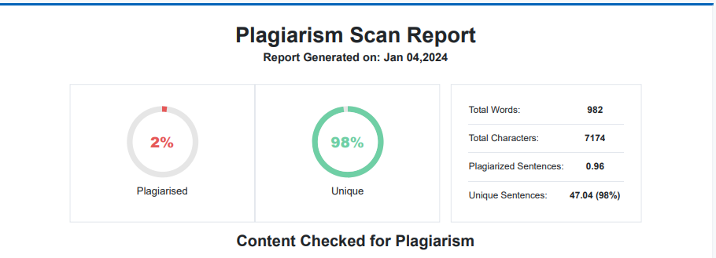
Publication Details

Slide 20

Thank You

